Slide 1
Linear Layout

Slide 2
Linear Layout
https://labs.udacity.com/android-visualizer/#/android/linear-layout

Slide 3

Observations about the code

Slide 4
Android Orientation
It specifies whether the layouts are to be displayed in a row or a column.

Slide 5
Now let’s try to :
Add more Text Views to the Linear Layout
Change the orientation

Slide 6
Width and Height
Types of dimensions we know:
Fixed width: dp
Variable width: wrap_content
Finally we have match_parent
Let’s test each and every one of these.
https://labs.udacity.com/android-visualizer/#/android/match-parent

Slide 7
Evenly spacing out the children

Slide 8
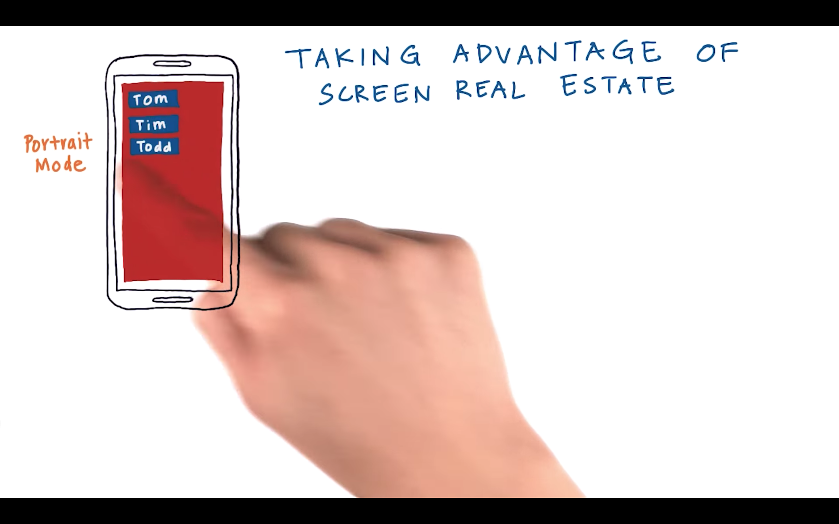

Slide 9
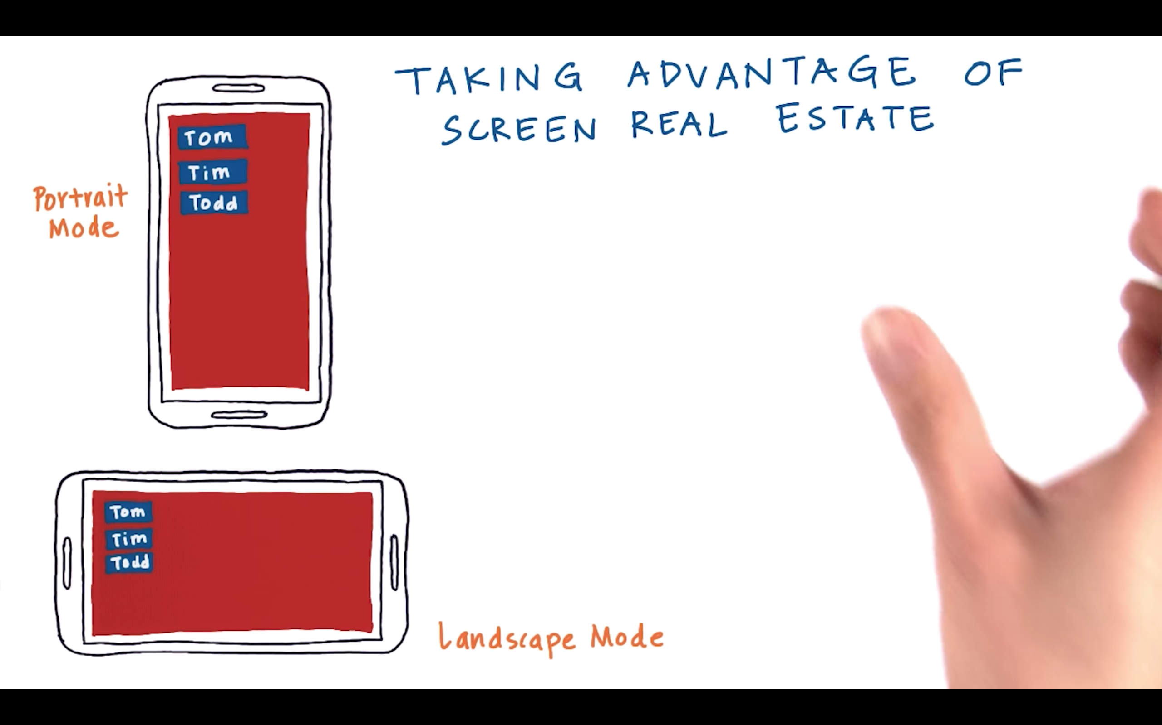

Slide 10
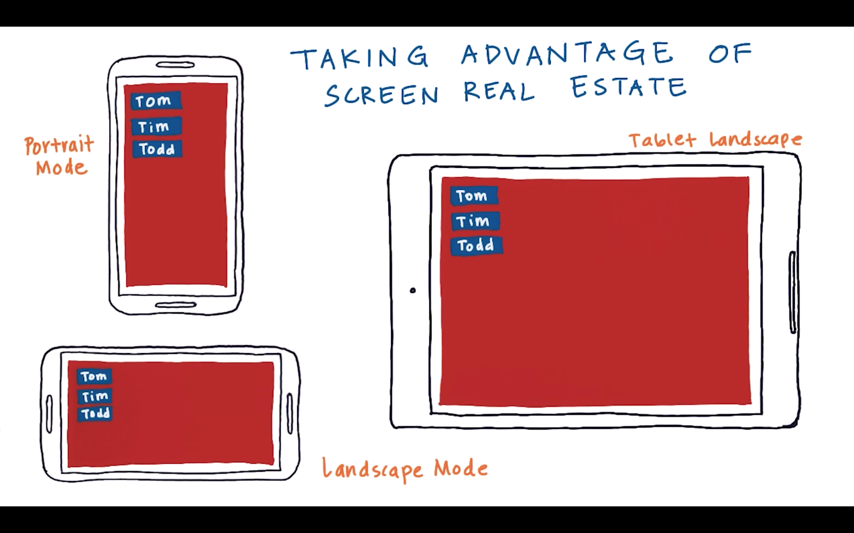

Slide 11
Let’s see how to even space them
https://labs.udacity.com/android-visualizer/#/android/equal-space-children

